Slide 1
The Gaming Industry
Group Members:
Shayan Haider 21k-3211
Ahmed Ali 21k-3212
Mohammad Yehya Hayati 21K-3309
Rafed Naeem 21k-3385
Asad Noor Khan 21k-4678
Taha Hassan 21k-4680

Slide 2
Content
1.Introduction
2. History of Gaming
3.Different Platforms
4.Gaming as a sport (E-Sports)
5.Popular Opinions
6.The Future

Slide 3
Introduction
The video game sector is immensely large. In fact, it is larger than the movie and music industries combined, and it is only growing.
Since it appeals to a wide range of ages, video games have become the toys for the next generation.
Due to this Top class companies like Google, Apple, and even Facebook are investing in the vast potential of the gaming world.

Slide 4
Statistics
In 2020, the gaming industry generated $155 billion in revenue, By 2025, analysts predict the industry will generate more than $260 billion in revenue.
In fact, 60% of Americans play video games on their platform regularly.

Slide 5

History of Gaming
Video games have been around for decades, but their popularity has increased in recent years.
The earliest of games include Snake, Pong, and also Pac-man.

Slide 6
Different Platforms
Games are made to be played for enjoyment and experiencing a new world. What’s the point when you can’t choose you preferred style.
VR (Virtual Reality) is a relatively new platform for gamers to play with. It essentially creates a virtual yet seeming less environment and feels as if it was real.
AR (Augmented Reality) is considered as the cousin of VR. It is not exactly as immersive but provides a new environment nevertheless.
Console was the progenitor of video games as it was the first to be created. Whether it be arcade machines or regular consoles, they are the ones that started the fiery passion for gaming.

Slide 7
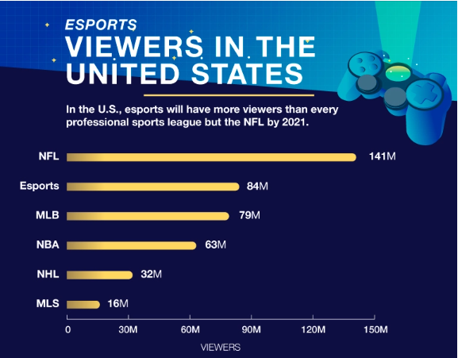
Gaming as a Sport (E-Sports)
Video games, which have been international recognized and possessing a large fan base, are eligible to garner attention to its competitive side.
E-Sports (Electronic Sports) is a sport in which professional players compete in a multiplayer game.
In fact, it is so highly sought after that it is among the top most watched sports in the world.

Slide 8
Popular Opinions
A popular negative point about gaming is that it affects your mental and physical health. Studies showing that due to gaming people have suffered from insomnia, depression, aggression, and even anxiety.
However, newer more authentic studies show that video games are secretly priming your memory for the rest of your life.
Due to improper posture, and over-usage of gaming may lead to detrimental health issues, therefore it should be done in moderation.

Slide 9
The Future
With the combination of VR and AR it would be possible to create or re-create entire universes filled with different interactions, and experiences. It would be possible to create your own fantasies.
With the expansion of NFTs (Non-Fungible Tokens) it would be possible to earn from playing games in your own rooms. Just think about that!

Slide 10
THE END!

